Slide 1

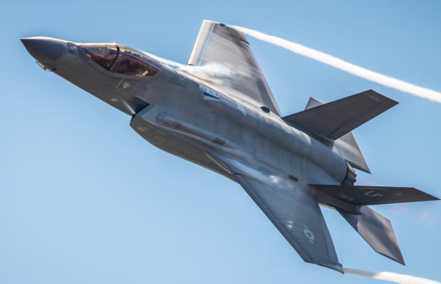
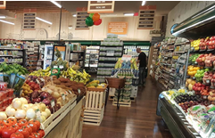

Food & Beverage Industry
M&A Market Update
June 2026

Slide 2
Introduction to Calabasas Capital
FINRA-registered Investment banking firm* serving privately held companies, including family-owned businesses and emerging growth companies, in the lower middle market ($10-$100mm revenue/$2-$12mm EBITDA)
Senior team of financial professionals with significant experience in M&A advisory and private placements
Strong domain expertise in target sectors and connectivity with senior management and boards of established companies and their financial sponsors
  Mergers & Acquisitions
  Capital Raising
    Business sales
    Subsidiary dispositions
    Business purchases
    Mergers and JVs
    Private Equity
    Subordinated Debt
    Senior Debt
*Calabasas Capital is a dba of Fallbrook Capital Securities Corp., member FINRA-SIPC.

Slide 3


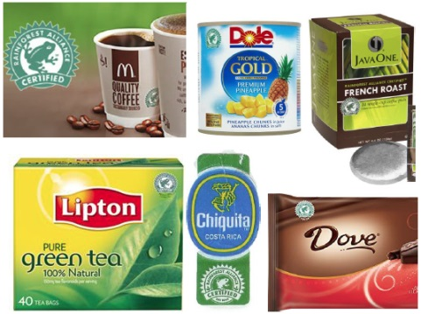

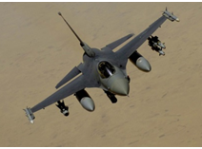
Industry Focus and Expertise
Consumer
Food & Beverage
E-Commerce
CPG
Retail/Restaurants
Tech / Business Services
SaaS/Software
Defense/Govt. Services
IT Enabled Services
Marketing/Media
Industrial
Aerospace & Defense
Industrial Tech
Manufacturing
Distribution

Slide 4
Senior Team
David Bonrouhi, Managing Director
  30 Years in Investment Banking & Private Equity
  Two years experience in Big 6 Public Accounting (PwC); CPA Licensed (non practicing)
  Series 7, 63 and 79 Securities Licenses with Fallbrook Capital
  M.S. in Tax; B.S. in Accounting (Miami Univ. (OH)); MBA UCLA Anderson School
Andrew D. Williamson, Managing Director
  17 Years in Investment Banking and VC
  4 Years in CFO/GM roles at PE backed companies (Merex Group, DM Natural Products)
  7 Years operating experience in VC backed software company (TSC) including 2 years with Oracle Corporation after being acquired.
  Licensed CA (ICAA), 3 years Big 6 Accounting & Consulting (PwC)
  Series 7, 63 and 79 Securities Licenses with Fallbrook Capital
  MBA UCLA Anderson School; Bachelors of Commerce (University of Western Australia)
  Sunil Joshi, Strategic Partner
  >20 years as healthcare industry consultant as principal of The Prospera Group.
  Series 63 and 79 Securities Licenses

Slide 5
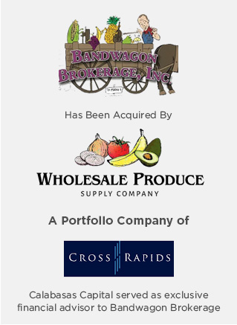
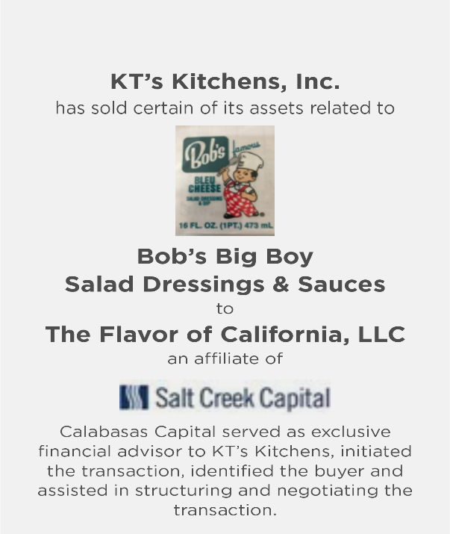

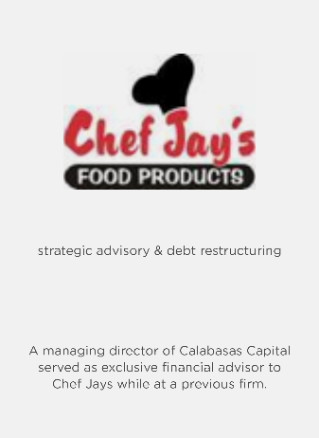
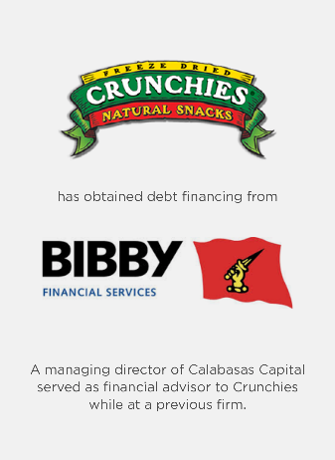
Calabasas Capital Knows the Food Industry

Slide 6
Food & Beverage M&A Deal Count by Buyer Type
The food and beverage sector continues to demonstrate resilience due to consistent consumer demand and strong strategic buyer interest.
Food and beverage M&A activity remained steady in 2025 with approximately 296 announced transactions, down 23% from 2024 while 2025 activity was the lowest since 2013 due largely to tariffs, geopolitical conflicts and macroeconomic uncertainty.
Source: Peakstone Food & Beverage Industry M&A and Valuation Insights, Capital IQ.

Slide 7
Trends in Food & Beverage M&A
Strategic acquirers continue to dominate transaction activity vs. financial buyers, with strategics accounting for approximately 88% of deals in 2025, as large food companies pursue acquisitions to expand product portfolio, gain exposure to faster-growing categories and strengthen their supply chains.
BY NUMBER OF ANNOUNCED DEALS
Sources: Kroll Food & Beverage M&A Update Feb 2026; Peakstone Food & Beverage Report Jan 2026.

Slide 8
Food & Beverage Median Transaction Value
While deal volume dropped in 2025, large deals dominated as noted by the average deal size jumping by 3x to $95 million, a 25-year high. Demand for high-quality assets remained high in 2025 as was the case in M&A in general.
Source: Peakstone Food & Beverage Industry M&A and Valuation Insights, Capital IQ.

Slide 9
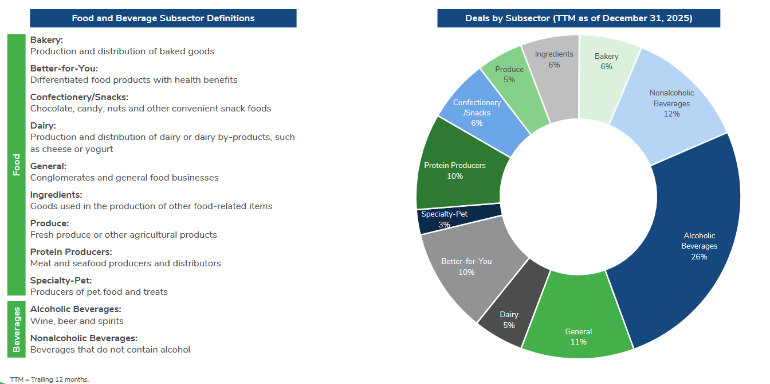
Trends in Food & Beverage M&A: Deals by Subsector
Source: Kroll Food & Beverage M&A Update, Winter 2026

Slide 10
F&B Public Company Trading Multiples
Source: Peakstone Food & Beverage Industry M&A and Valuation Insights, Capital IQ.

Slide 11
F&B Private M&A Valuation Multiples
Source: Peakstone Food & Beverage Industry M&A and Valuation Insights, Capital IQ.

Slide 12
Global PE Activity in CPG Food & Beverage
Global private equity activity in food & beverage CPG started 2026 on steady footing with an estimated 144 deals—the fifth-highest quarterly count in nine years.
Source: Pitchbook Q1 2026 Food & Beverage CPG Report, May 2026
.

Slide 13
Global PE Exits in the Food & Beverage Sector
Global private equity exit activity in food & beverage CPG in Q1 2026 was $4.3 billion in terms of value across 27 exits.
This annualizes to roughly half of 2025’s $36.4 billion pace.
Source: Pitchbook Q1 2026 Food & Beverage CPG Report, May 2026
.

Slide 14
Food & Beverage M&A Outlook
2026 is expected to be strong with both strategic buyers and financial sponsors showing a growing appetite for M&A following low levels of capital deployment in 2025.
  Encouragingly, in the 1st Quarter of 2026, there were 60 deals completed in F&F in N. America, an increase of 5% from Q4 2025 and a 20% YOY increase from Q1 2025.
Biggest challenges:
  GLP-1 Drugs – compelling consumers to favor high protein and fiber, low‑calorie diets, and a thoughtful approach to eating
  Tarrifs – creates uncertainty, leads to supply chain shifts, and stockpiling
  Input Inflation – ingredients, packaging and more recently freight
1. Source: Kroll Food & Beverage M&A Update, Spring 2026

Slide 15
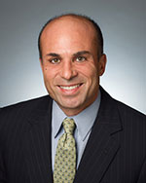
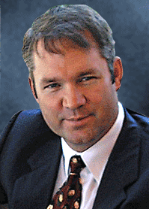
David Bonrouhi
Managing Director
Mobile: (213) 500-4135
david@calabasascapital.com
Andrew D. Williamson
Managing Director
Mobile: (310) 892-6209
andrew@calabasascapital.com
26610 Agoura Road, Suite 120 Calabasas, CA 91302 | Phone: (818) 657-6130 Fax: (818) 657-6145

