Slide 1

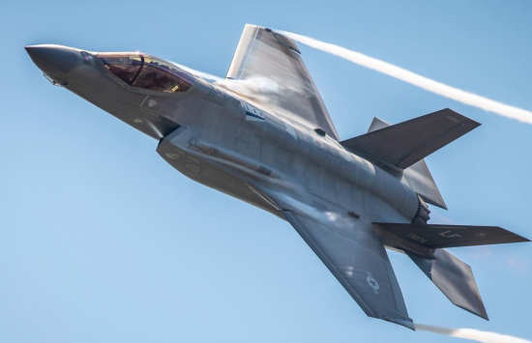
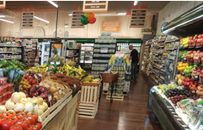

Food & Beverage Industry
M&A Market Update
March 2026

Slide 2
Introduction to Calabasas Capital
FINRA-registered Investment banking firm* serving privately held companies, including family-owned businesses and emerging growth companies, in the lower middle market ($10-$100mm revenue/$2-$12mm EBITDA)
Senior team of financial professionals with significant experience in M&A advisory and private placements
Strong domain expertise in target sectors and connectivity with senior management and boards of established companies and their financial sponsors
Mergers & Acquisitions
Capital Raising
Business sales
Subsidiary dispositions
Business purchases
Mergers and JVs
Private Equity
Subordinated Debt
Senior Debt
*Calabasas Capital is a dba of Fallbrook Capital Securities Corp., member FINRA-SIPC.

Slide 3


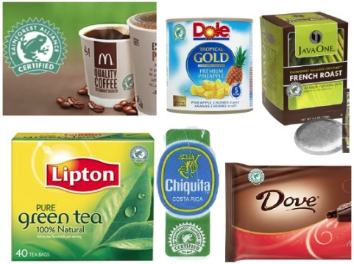

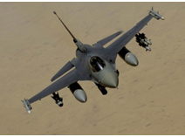
Industry Focus and Expertise
Consumer
Food & Beverage
E-Commerce
CPG
Retail/Restaurants
Tech / Business Services
SaaS/Software
Defense/Govt. Services
IT Enabled Services
Marketing/Media
Industrial
Aerospace & Defense
Industrial Tech
Manufacturing
Distribution

Slide 4
Senior Team
David Bonrouhi, Managing Director
30 Years in Investment Banking & Private Equity
Two years experience in Big 6 Public Accounting (PwC); CPA Licensed (non practicing)
Series 7, 63 and 79 Securities Licenses with Fallbrook Capital
M.S. in Tax; B.S. in Accounting (Miami Univ. (OH)); MBA UCLA Anderson School
Andrew D. Williamson, Managing Director
17 Years in Investment Banking and VC
4 Years in CFO/GM roles at PE backed companies (Merex Group, DM Natural Products)
7 Years operating experience in VC backed software company (TSC) including 2 years with Oracle Corporation after being acquired.
Licensed CA (ICAA), 3 years Big 6 Accounting & Consulting (PwC)
Series 7, 63 and 79 Securities Licenses with Fallbrook Capital
MBA UCLA Anderson School; Bachelors of Commerce (University of Western Australia)
Sunil Joshi, Strategic Partner
>20 years as healthcare industry consultant as principal of The Prospera Group.
Series 63 and 79 Securities Licenses

Slide 5
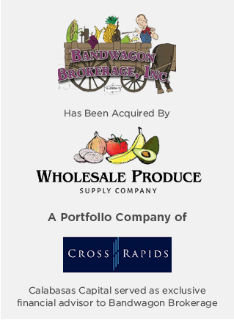
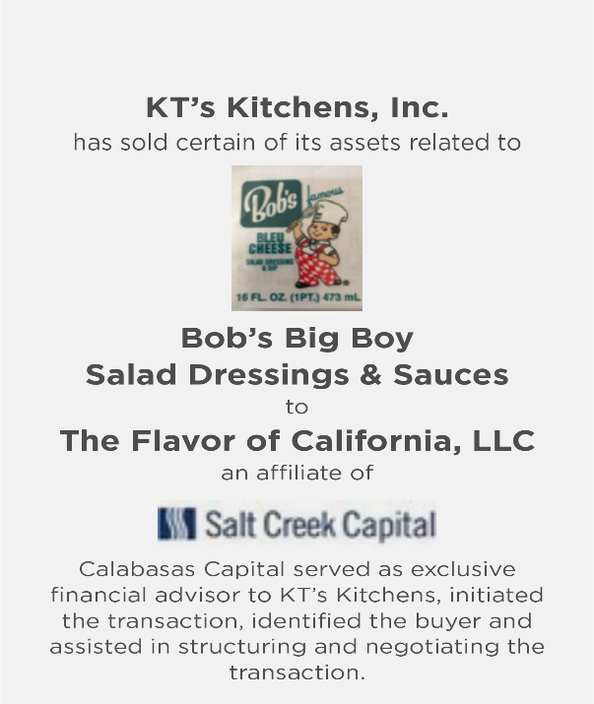

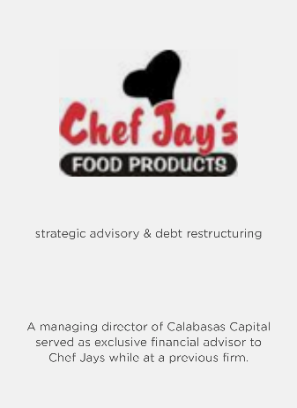
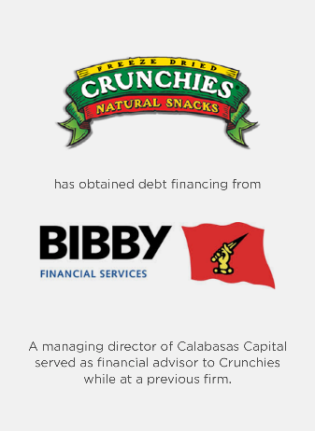
Calabasas Capital Knows the Food Industry

Slide 6
Trends in Food & Beverage M&A
Food and beverage M&A activity remained steady in 2025 with approximately 296 announced transactions, down 23% from 2024 while 2025 activity was the lowest since 2013 due largely to tariffs, geopolitical conflicts and macroeconomic uncertainty.
The food and beverage sector continues to demonstrate resilience due to consistent consumer demand and strong strategic buyer interest.
Strategic acquirers continue to dominate transaction activity vs. financial buyers, with strategics accounting for approximately 88% of deals in 2025, as large food companies pursue acquisitions to expand product portfolio, gain exposure to faster-growing categories and strengthen their supply chains.
While deal volume in 2025, large deals dominated as noted by the average deal size jumping by 3x to $95 million, a 25-year high. Demand for high-quality assets remained high in 2025 as was the case in M&A in general.
2026 is expected to be strong with both strategic buyers and financial sponsors showing a growing appetite for M&A following low levels of capital deployment in 2025. This has put pressure on financial sponsors to deploy capital and generate returns for limited partners, and on strategic buyers to seek synergistic add-on opportunities.
Source: Kroll Food & Beverage M&A Update, Winter 2026

Slide 7
Trends in Food & Beverage M&A
BY NUMBER OF ANNOUNCED DEALS
Sources: Kroll Food & Beverage M&A Update Feb 2026; Peakstone Food & Beverage Report Jan 2026.

Slide 8
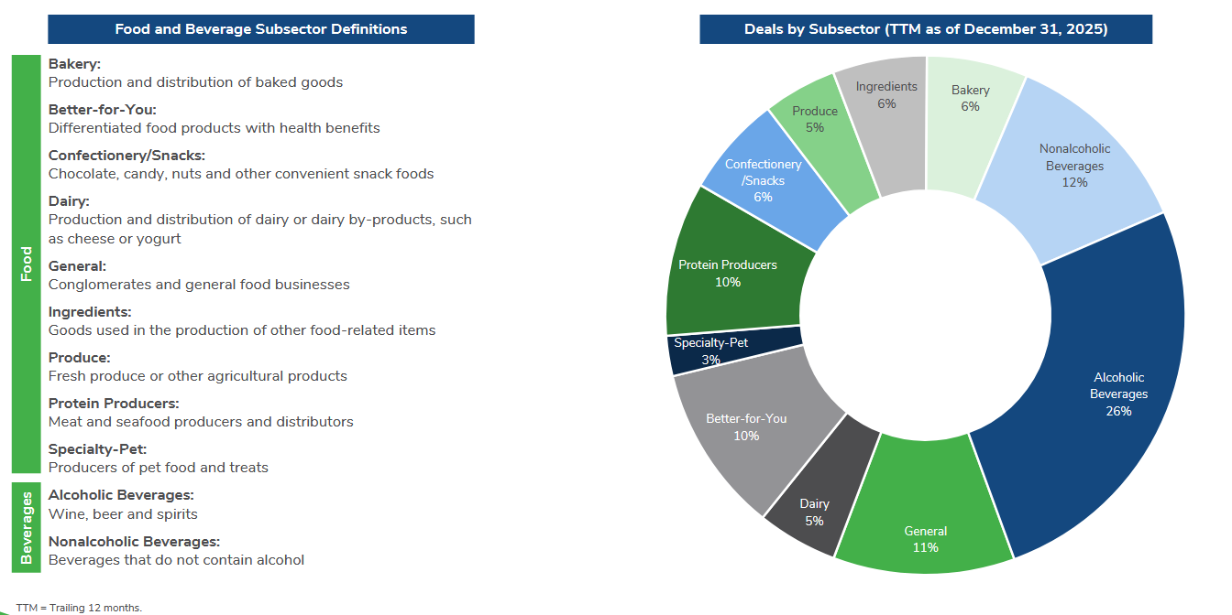
Trends in Food & Beverage M&A: Deals by Subsector
Source: Kroll Food & Beverage M&A Update, Winter 2026

Slide 9
Food & Beverage M&A Deal Count by Buyer Type
Source: Peakstone Food & Beverage Industry M&A and Valuation Insights, Capital IQ.

Slide 10
Food & Beverage Median Transaction Value
Source: Peakstone Food & Beverage Industry M&A and Valuation Insights, Capital IQ.

Slide 11
F&B Public Company Trading Multiples
Source: Peakstone Food & Beverage Industry M&A and Valuation Insights, Capital IQ.

Slide 12
F&B Private M&A Valuation Multiples
Source: Peakstone Food & Beverage Industry M&A and Valuation Insights, Capital IQ.

Slide 13
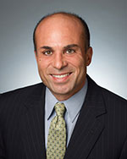
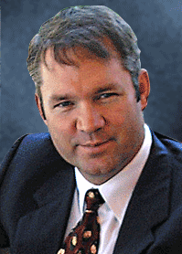
David Bonrouhi
Managing Director
Mobile: (213) 500-4135
david@calabasascapital.com
Andrew D. Williamson
Managing Director
Mobile: (310) 892-6209
andrew@calabasascapital.com
26610 Agoura Road, Suite 120 Calabasas, CA 91302 | Phone: (818) 657-6130 Fax: (818) 657-6145

